Slide 1

SECP3623 DATABASE PROGRAMMING
TOPIC 09 – Advanced Operations in MongoDB

Slide 2
LECTURE LEARNING OUTCOME
By the end of this lecture, students should be able to:
Apply indexing techniques in MongoDB to optimise query performance.
Perform sorting operations on MongoDB query results.
Use aggregation pipelines for data analysis.
Execute advanced queries using MongoDB operators.

Slide 3
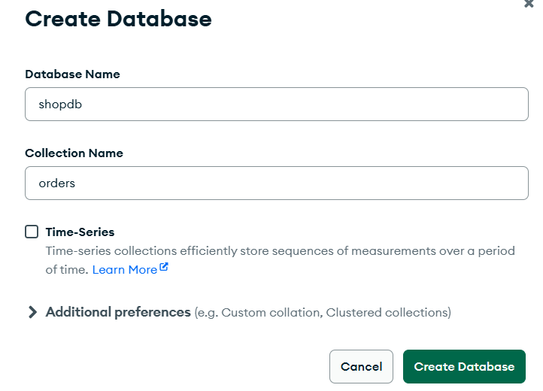
Create Database & Collection
Database created: shopdb
Collection created: orders
You can now proceed with:
Insert documents
Sorting
Indexing
Aggregation
Advanced queries

Slide 4
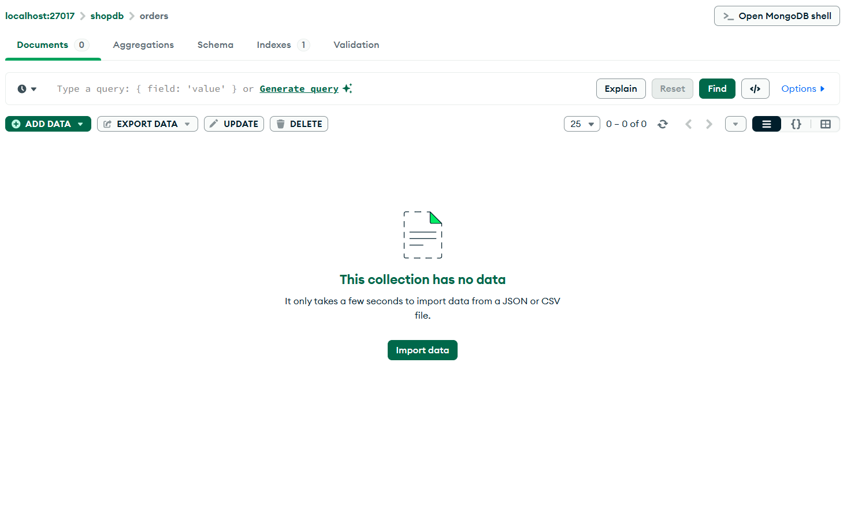
Create Database & Collection

Slide 5
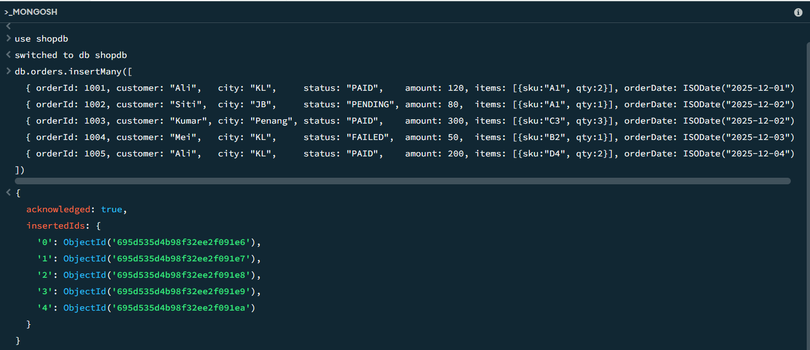
Insert Data

Slide 6
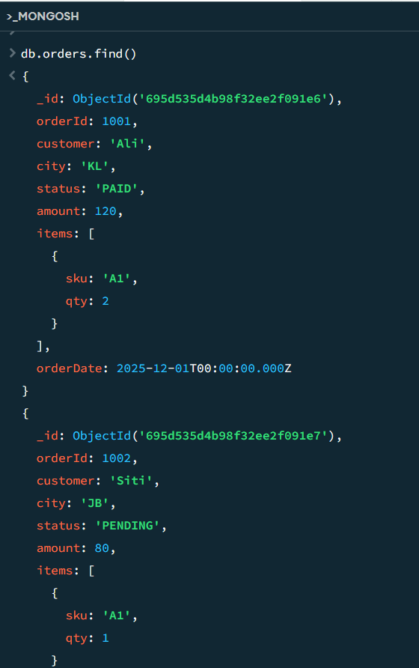
Verify Data
db Refers to the current database in use (shopdb).
orders The collection name where order records are stored.
find() A MongoDB method used to query documents from a collection.

Slide 7
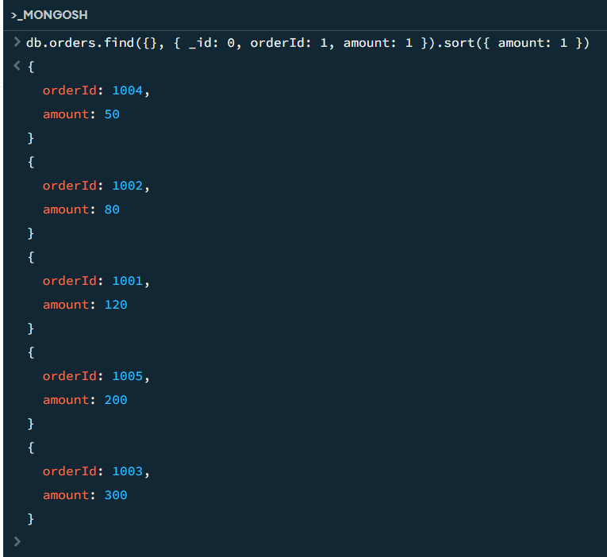
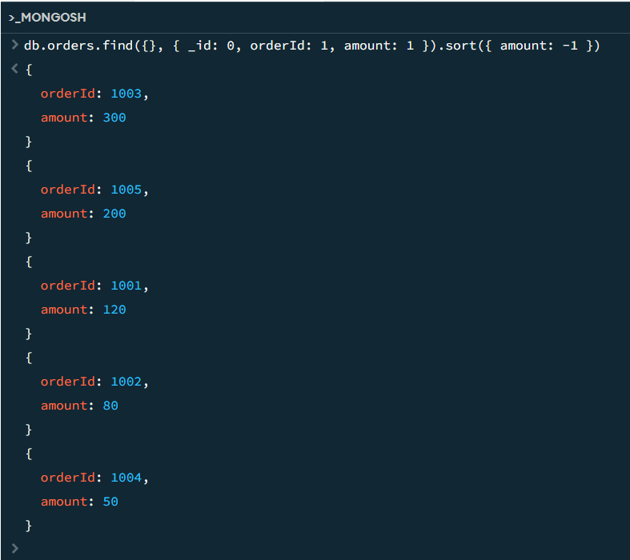
Sorting in MongoDB
Sorting allows query results to be arranged in ascending (1) or descending (-1) order.
Ascending
Descending
It displays only the order ID and amount for all orders, sorted by amount from lowest to highest.
It displays order ID and amount, sorted by amount from highest to lowest.

Slide 8
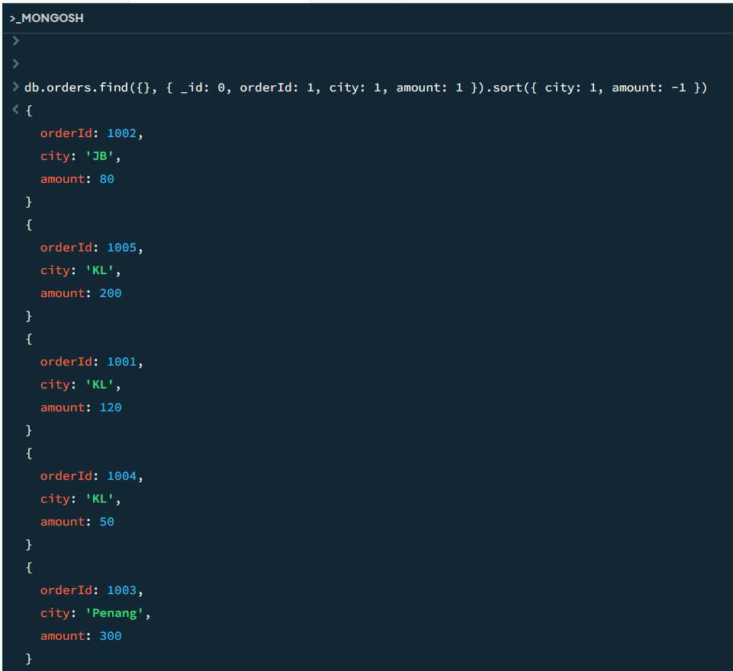
Sorting in MongoDB
Sort by city then amount
It shows the order ID, city, and amount for all orders, grouped by city in alphabetical order, and within each city, sorted by amount from highest to lowest.

Slide 9
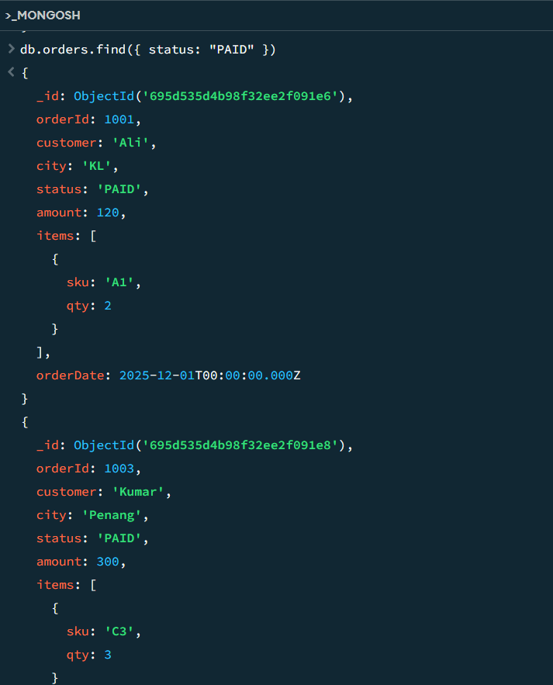
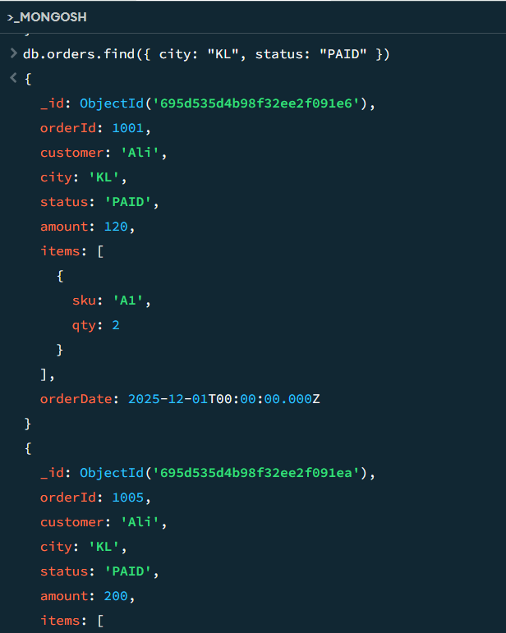
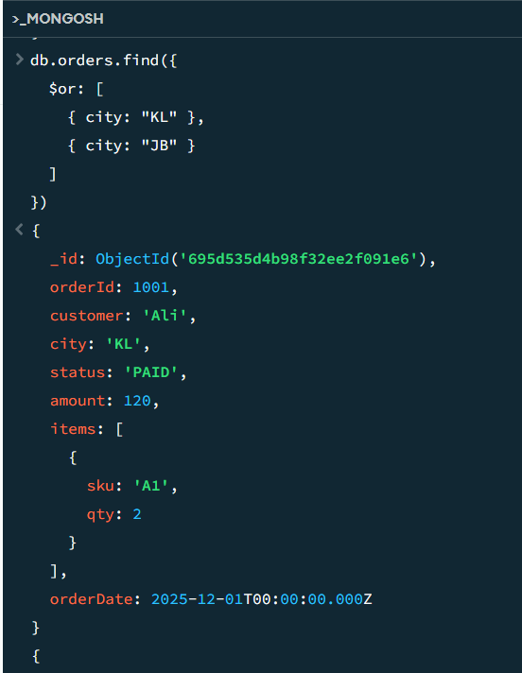
Advanced Query Operators: conditions, ranges, patterns, and arrays
1. Conditions : Condition operators filter documents based on logical or comparison rules.
Find orders with status PAID
Combine conditions (AND)
Logical OR

Slide 10
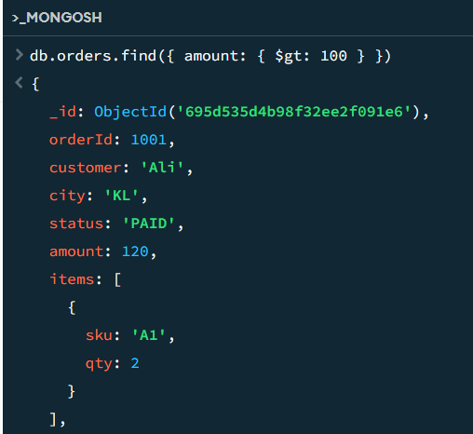
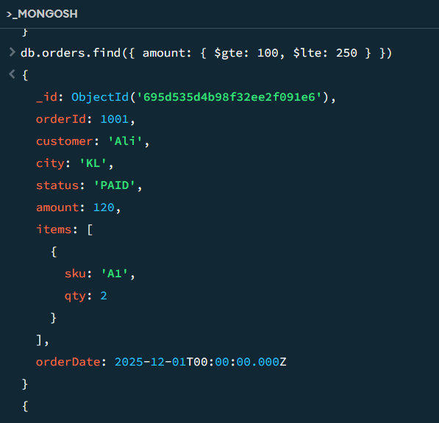
Advanced Query Operators: conditions, ranges, patterns, and arrays
2. Ranges : Range operators retrieve data where values fall within a specified range.
Amount greater than 100
Amount between 100 and 250

Slide 11
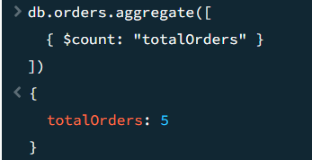
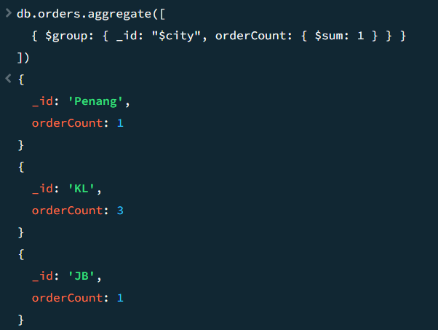
Advanced Query Operators: conditions, ranges, patterns, and arrays
Count total number of orders
Count Documents by Group (GROUP COUNT)
$group groups documents by city
$sum: 1 adds 1 for each document
Result = count per city

Slide 12
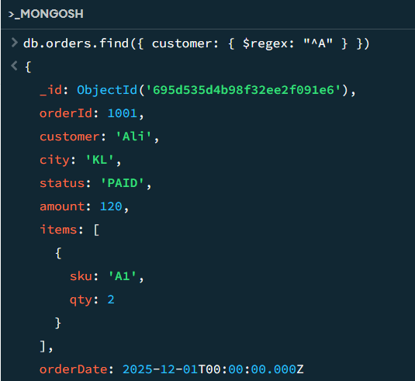
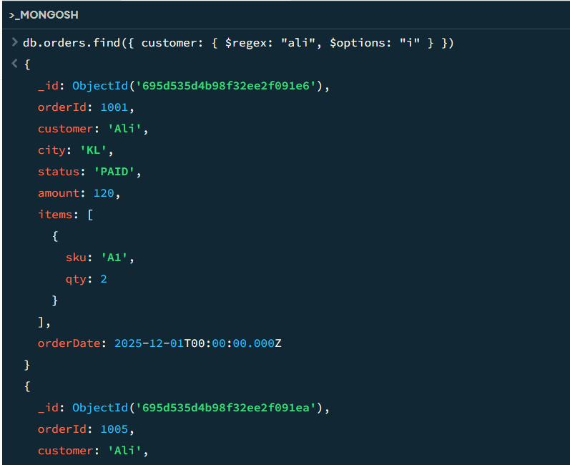
Advanced Query Operators: conditions, ranges, patterns, and arrays
3. Patterns : Pattern matching allows searching text values using regular expressions.
Customer name starts with “A”
Case-insensitive search
$regex
MongoDB operator for pattern matching using regular expressions
$options: "i"
"i" means case-insensitive
Uppercase and lowercase letters are treated the same

Slide 13
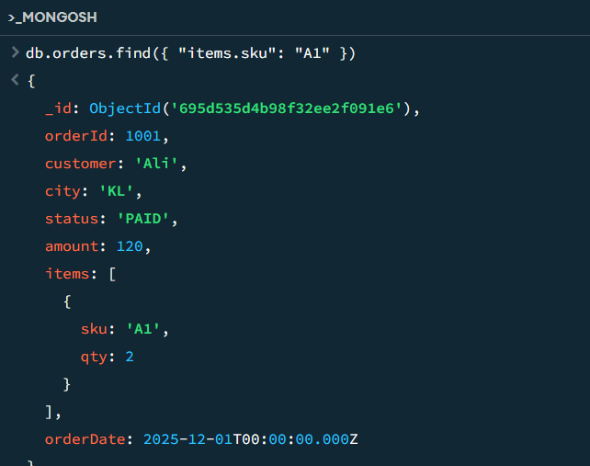
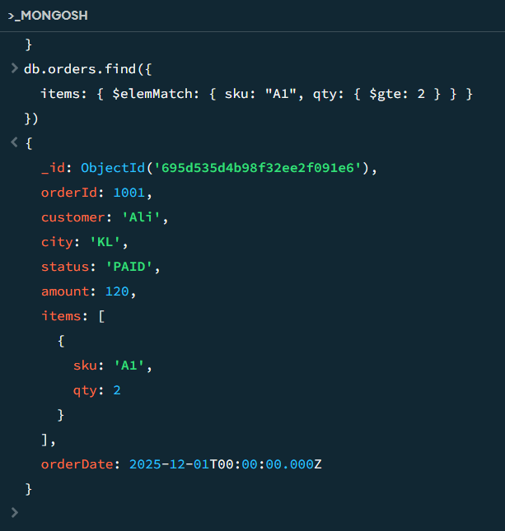
Advanced Query Operators: conditions, ranges, patterns, and arrays
4. Arrays : Array operators query nested or array-based data within documents.
Find orders containing SKU A1
Match multiple conditions in an array element
$elemMatch
Ensures all conditions apply to the same array element
Without $elemMatch, MongoDB may match conditions across different elements, which can give incorrect results
Conditions applied to one item object:
sku: "A1" → item SKU must be A1
qty: { $gte: 2 } → quantity must be 2 or more
Both conditions must be true in the same item.
items.sku"
Uses dot notation
items is an array field inside each order document.
Tells MongoDB to look inside each object in the items array

Slide 14
Benefits of Indexing in MongoDB
Faster data retrieval Indexes allow MongoDB to locate required data quickly without scanning every document in a collection.
Improved query performance Queries that filter data using conditions (such as equality or range conditions) run much faster when relevant indexes are available.
Efficient sorting of results Indexes help MongoDB return sorted data directly, reducing the need for additional processing and memory usage.
Better scalability for large datasets As the size of the database grows, indexed queries continue to perform efficiently, while non-indexed queries become slower.
Reduced system resource usage By examining fewer documents, indexing reduces CPU and memory consumption on the database server.
Optimised aggregation operations Indexes improve the performance of aggregation stages that involve filtering and sorting of data.
Enhanced support for read-heavy applications Indexing is especially beneficial for applications that perform frequent searches, reporting, or monitoring.
Improved overall database efficiency Indexes help the query planner choose the most efficient execution path, leading to better overall system performance.

Slide 15

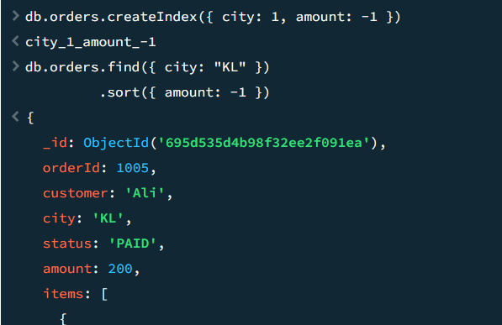
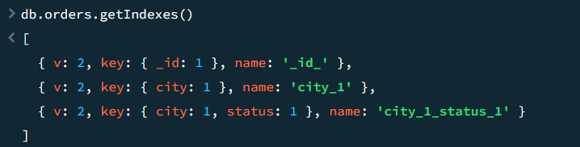
Indexing in MongoDB
Indexes improve query performance by allowing MongoDB to locate data faster, especially when working with large datasets.
Create Index on city
Index for Filter + Sort Together
View on all index
Why index helps
Filters by city
Returns data already sorted by amount

Slide 16
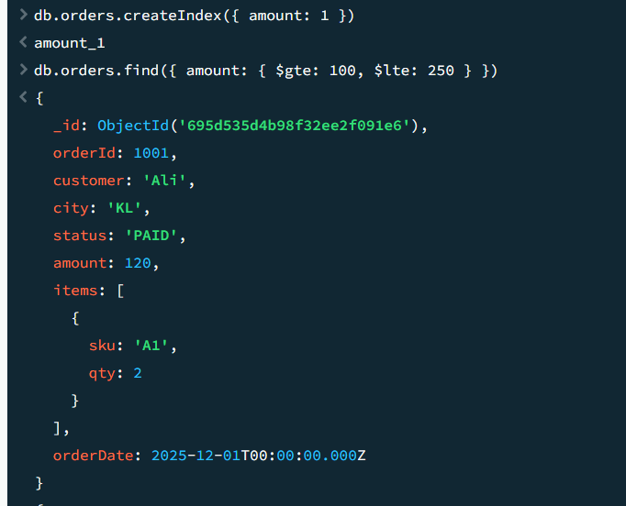
Using Index for Range Queries in MongoDB
Create an index on the amount field in the orders collection.
Retrieve all orders where the amount is between 100 and 250 (inclusive).
$gte: 100
Means greater than or equal to 100
Includes 100
$lte: 250
Means less than or equal to 250

Slide 17

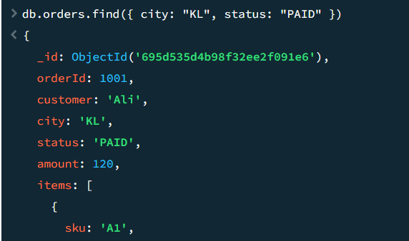
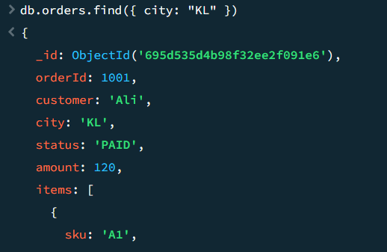
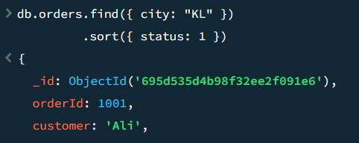
Compound Index
Create a Compound Index
Create a compound index on city and status:
Query that Uses the Compound Index
Query Using Only the First Field (Try !)
Query Using Only the Second
Field (Try !)
Will get output however,
this query does not efficiently use the compound index because it skips the first field.
Compound Index with Sorting

Slide 18
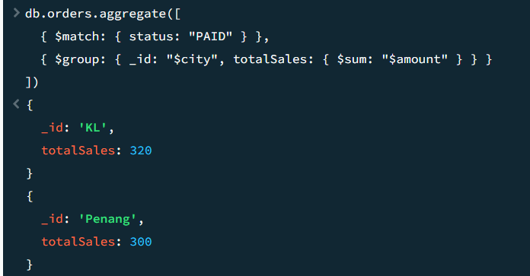
Aggregation
Aggregation pipelines process data in stages to perform grouping, calculations, and transformations, similar to SQL GROUP BY.
Total sales by city
aggregate([ ... ])
aggregate() is used to perform data processing and analysis
It works using a pipeline, where each stage processes the output of the previous stage
Stage 1: $match
{ $match: { status: "PAID" } }
What it does
Filters documents to include only PAID orders
Similar to a WHERE clause in SQL
Stage 2: $group
{ $group: { _id: "$city", totalSales: { $sum: "$amount" } } }
a) _id: "$city"
Groups documents by city
Each unique city becomes one output document
b) totalSales: { $sum: "$amount" }
Adds up ($sum) the amount values
Computes total sales per city
SELECT city, SUM(amount) AS totalSales
FROM orders
WHERE status = 'PAID'
GROUP BY city;

Slide 19
Aggregation – Practice !
Total spending per customer and totalSpent in descending order using MongoDB.
SELECT customer, SUM(amount) AS totalSpent
FROM orders
GROUP BY customer
ORDER BY totalSpent DESC;
Notes:
db.orders.aggregate([
{ $group: { _id: "$customer", totalSpent: { $sum: "$amount" } } },
{ $sort: { totalSpent: -1 } }
])

Slide 20
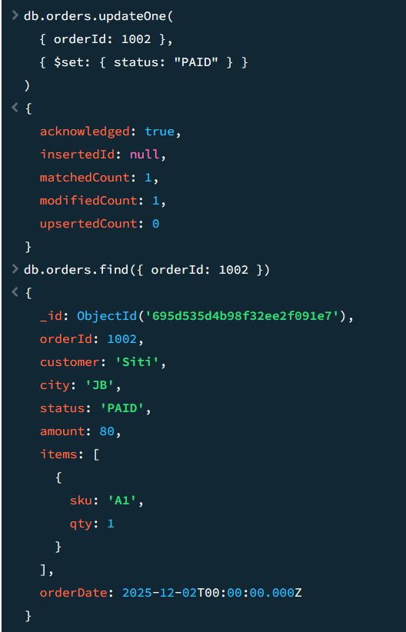
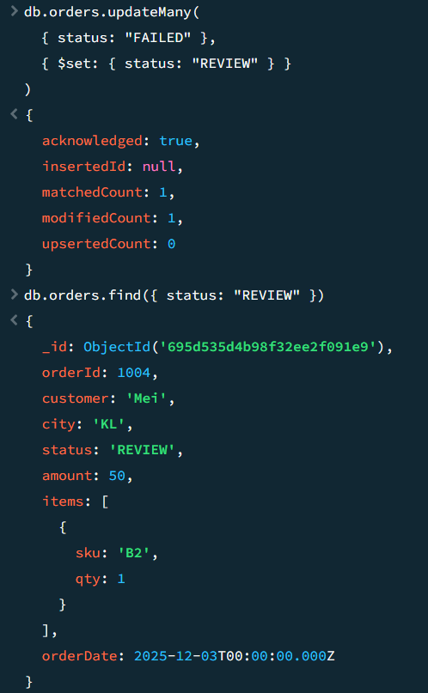
Update in MongoDB
1) Update ONE document (updateOne)
Use when you want to change only the first matching document.
2) Update MANY documents (updateMany)
Use when you want to change all documents that match the filter.
Use when you want to change all documents that match the filter. Set status = "REVIEW" for all FAILED orders
Update status for orderId 1002 to PAID

Slide 21
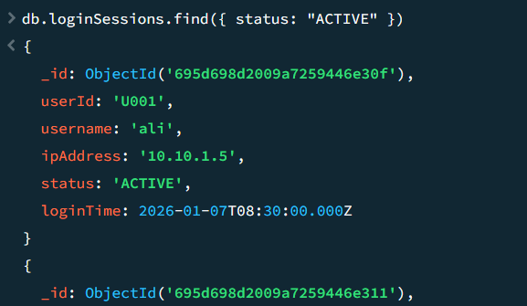
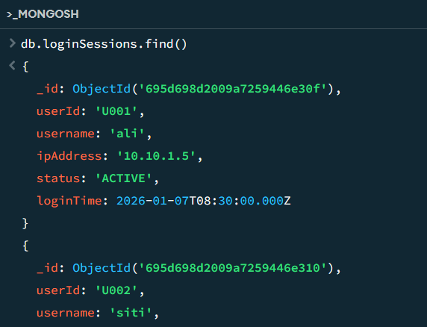
Retrieve in MongoDB
Retrieve Active Login Sessions
4. Retrieve all ACTIVE sessions
Create a collection called loginSessions that stores user login activity.
Insert many sample login session records
Example :
userId: "U001",
username: "ali",
ipAddress: "10.10.1.5",
status: "ACTIVE",
loginTime: ISODate("2026-01-07T08:30:00Z")
3. Verify data

Slide 22
Delete in MongoDB
Attempt this query !
Delete one ACTIVE session for user ali
db.loginSessions.deleteOne({ username: "ali", status: "ACTIVE" })
Delete ALL inactive sessions
db.loginSessions.deleteMany({ status: "INACTIVE" })
Delete ALL documents in a collection (use with care)
db.loginSessions.deleteMany({})
deleteOne() removes a single record, deleteMany() removes multiple records, and drop() removes the entire collection.
Drop the entire collection (It’s destructive)
db.loginSessions.drop()
Deletes:
Collection
All documents
All indexes

Slide 23
EXERCISE
Database: shopdb Collection: orders
Question 1 – Advanced Query (Condition + OR)
Retrieve all orders where the status is either PAID or PENDING, but city is NOT KL.
Question 2 – Sorting (Multi-field)
Display only orderId, city, and amount, sorted by:
city in descending order
amount in ascending order
Question 3 – Aggregation (Count under Condition)
Calculate the number of orders per city where the amount is greater than 100.
Question 4 – Indexing (Compound Index Usage)
Create a compound index that optimises queries filtering by customer and status, then write one query that benefits from this index.
Question 5 – Data Modification (Update + Delete)
a) Update all orders with status "FAILED" to "CLOSED". b) Delete all orders where the amount is less than 70.

Slide 24


